Slide 1
ECE 471
Communication Theory
802.11
Standards
Presentation by:
Jenny Doan
Daniel Noyes

Slide 2

What is the 802.11 Standard?
IEEE standard for wireless communication.
Allows roaming computers to talk to other devices through a peer to peer network.
Also allows devices to connect to each other via an access point or extension point which is the transmitter or receiver.
This allows users to share and exchange data with one another.

Slide 3
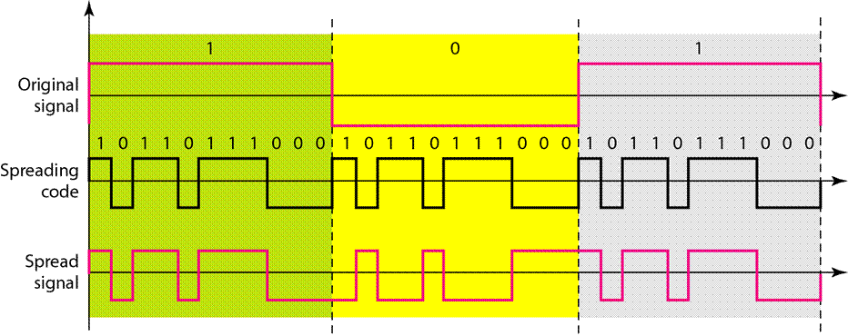
Spread Spectrum
The carrier signals occur over the full bandwidth or spectrum of a device's transmitting frequency.
Transmit with a unique spreading code.

Slide 4
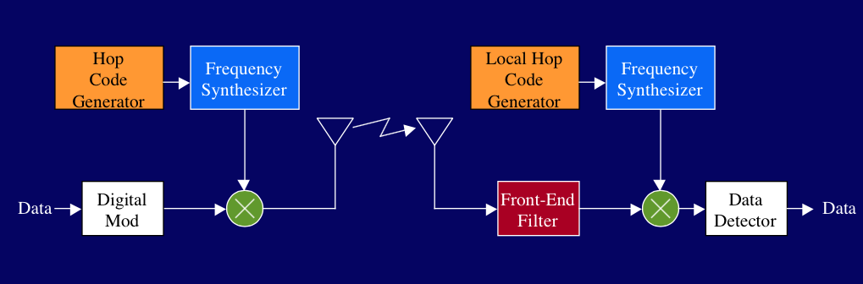
Frequency Hopping Spread Spectrum (FHSS) Block Diagram 802.11

Slide 5
Frequency Hopping Spread Spectrum (FHSS)
802.11
Uses 79 separate 1 MHz channels
Hops about every 0.1 sec (2.5 hop/sec)
Pseudo random hopping pattern
Gaussian Frequency Shift Keying
Immune to single frequency noise, has trouble with wideband noise

Slide 6
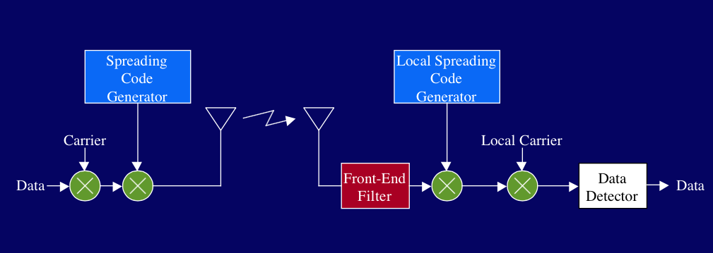
Direct Sequence Spread Spectrum (DSSS)
Block Diagram 802.11, 802.11b

Slide 7
Direct Sequence Spread Spectrum (DSSS)
802.11 and 802.11b
Phase-Shifts a sine wave pseudorandomly with a continuous string of pseudonoise (PN) code symbols called "chips".
Transmission Method: Multiply the data being transmitted by the PN.
The PN is a sequence of 1 and -1 values at the chip rate. This rate is much higher than the original signal rate.
Modulation
Differential Binary Phase Shift Keying
Differential Quadrature Phase Shift Keying

Slide 8
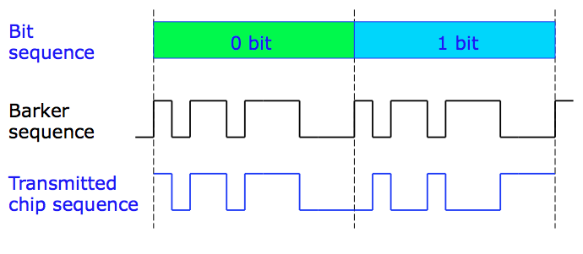
Encoding with 11-chip Barker sequence
802.11b
Used only at 1 and 2 Mbits/sec, CCK is used at higher bit rates 5.5 and 11 Mbits/sec

Slide 9
DSSS Benefits
802.11 and 802.11b
Benefits:
Resistance to intended or unintended jamming
Sharing of a single channel among multiple users
Reduced signal/background-noise level hampers interception
Determination of relative timing between transmitter and receiver

Slide 10
Complementary Code Keying (CCK)
802.11b
Supplement the Barker Sequence to achieve higher data rates than 2Mbps at the expense of a shorter distance.
Because of shorter chipping sequence (8 vs. 11)
Encode more bits
4 chipping sequences at 5.5 Mbps and 64 chipping sequences at 11 Mbps

Slide 11
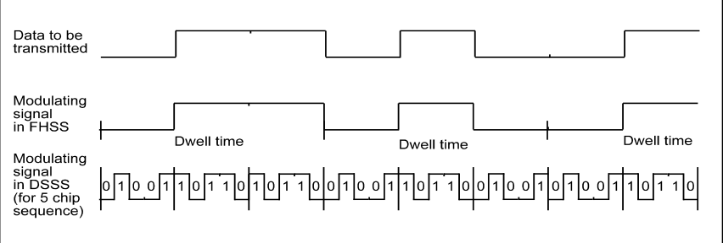
Signal being modulated with FHSS vs. DHSS
802.11

Slide 12
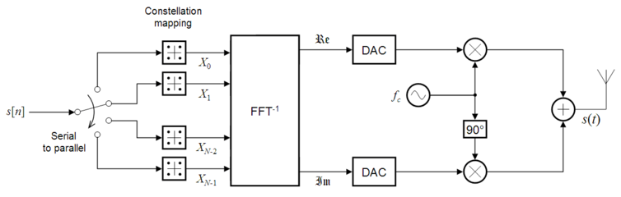
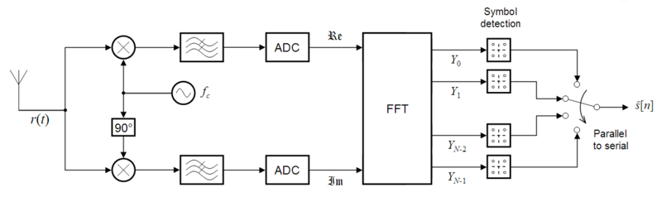
Orthogonal Frequency Division Multiplexing
802.11A, 802.11G, 802.11N, 802.11AC
Block Diagram

Slide 13
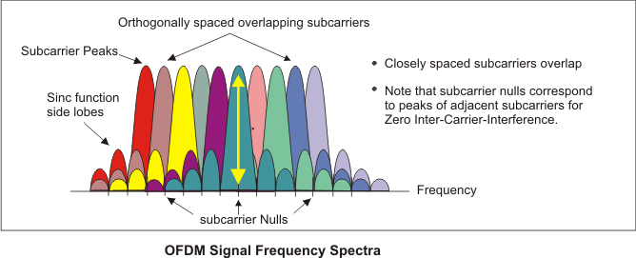
Orthogonal Frequency Division Multiplexing (OFDM)
802.11A, 802.11G, 802.11N, 802.11AC
Multi-Carrier Modulation
Immunity to selective fading
Divide overall channel into multiple narrowband signals
Resilience to interference

Slide 14
QAM: Quadrature Amplitude Modulation
802.11A/B/G/N - 64 QAM
802.11AC - 256 QAM
Communication Method to transfer higher data rate in one signal.
Encode bits based on a Amplitude and Phase.
Higher QAM will lead to transmitting of more bits per symbol. This can also lead to noise error due to the points being closer together.
Higher bit encoding means higher error rate.
Lower QAM is more reliable than higher QAM

Slide 15
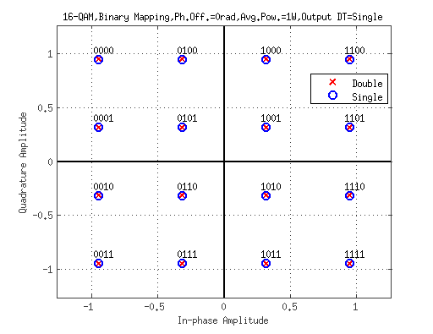
QAM Simulation
802.11 G & 802.11AC
Encoding a 16-QAM Signal
QAM Constellation was set up with a gray code approach to minimize error bits.
Created through MATLAB Simulink Rectangular QAM routine.

Slide 16
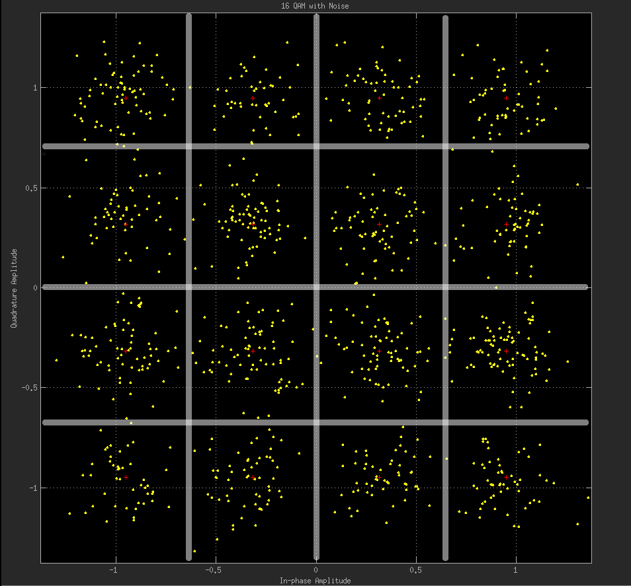
Reason For Grey Code
Minimize bit error to one bit change
Example shows various points affected by noise. These changed to another Symbol encoding.

Slide 17
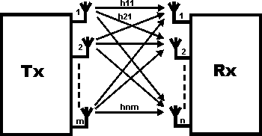
MIMO
Allows multiple inputs and outputs.
Able to communicate simultaneously to more devices.
Increase data transmission

Slide 18
Common Standards Used Today
802.11G
802.11N
Date of Approval: June 2003
Maximum Data Rate: 54Mbps
Modulation
CCK
DSSS
OFDM
RF Band: 2.4GHz
Channel Width: 20MHz
Date: Oct 29, 2009
Maximum Data Rate: 600Mbps
RF Band: 2.4 or 5GHz
Modulation
CCK
DSSS
OFDM
4 spatial streams
Channel Width: 20 or 40 MHz
Introduction to MIMO
Antenna Technology
Backwards compatible

Slide 19
Future 802.11 Standards
802.11AC
Date of Approval: January 2014
Builds upon the 802.11n
Wider Channels (80 or 160 MHz)
5GHz Frequency Band
More spatial streams (8 vs. 4)
433.3Mbps per stream (80 MHz channel)
Higher order modulation (256-QAM vs. 64-QAM)
Addition of a MU-MIMO
Other standards will be built upon the 802.11AC

Slide 20
Current 802.11 Specifications
Standard: | Max Data Rate: | Modulation: | Freq Band: | Bandwidth:
802.11 | 2 Mbit/s | DSSS,FHSS | 2.4 GHz | 22 MHz
802.11A | 54 Mbit/s | OFDM | 5 GHz | 20 MHz
802.11B | 11 Mbit/s | DSSS | 2.4 GHz | 22 MHz
802.11G | 54 Mbit/s | OFDM,DSSS | 2.4 GHz | 20 MHz
802.11N | 600 Mbit/s | OFDM | 2.4/5 GHz | 20/40 MHz
802.11AC | ~1 Gbit/s | OFDM | 5 GHz | 20/40/80/160 MHz

Slide 21
Learn From class correlations to the standard
With all of this, now you can see why Communication Theory is important in our daily lives.

Slide 22
Questions?

Slide 23
References
ieee1451.nist.gov/Workshop_04June01/Gilsinn.pdf
http://www.slideshare.net/AbhishekPachisia/ieee-80211-15604512
http://www.radio-electronics.com/info/wireless/wi-fi/ieee-802-11g.php
http://www.radio-electronics.com/info/rf-technology-design/ofdm/ofdm-basics-tutorial.php
http://eeemea.in/wp-content/uploads/2014/02/mimo-general-outline.gif
https://upload.wikimedia.org/wikipedia/commons/thumb/4/4e/OFDM_transmitter_ideal.png/754px-OFDM_transmitter_ideal.png
https://upload.wikimedia.org/wikipedia/commons/thumb/9/90/OFDM_receiver_ideal.png/800px-OFDM_receiver_ideal.png
people.cs.clemson.edu/~westall/851/fhss_dsss.pdf
http://sharmamonika95.blog.com/files/2012/10/dsss1.gif
http://grouper.ieee.org/groups/802/11/ieee802-11-logo.jpg
http://rfmw.em.keysight.com/wireless/helpfiles/89600B/WebHelp/subsystems/wlan-ofdm/Content/resources/image/ofdm%20orthogonalspacedsubcarriers.png

